Slide 1
MKT2291 Integrated Marketing Communications i
MIDTERM ASSESSMENT REVIEW

Slide 2
Format Assessment will be a timed INDIVIDUAL assignment on Brightspace. Individual advertisements will be emailed to each student prior to the exam.
DATE:
Application Based
Part A: Ad Analysis 5 questions (total marks: 80)
Part B: Short Answer 2 questions (total marks: 20)
All require written responses in the space provided on the exam
Chapters 1, 2, 3, 4, and 5
In class workshops and assignments
**Contributes 20% to your final grade
**You must pass the cumulative exams (mid term and final) to pass this course

Slide 3
Rationale
Definition (Merriam-Webster)
an explanation of controlling principles of opinion, belief, practice, or phenomena
an underlying reason
Synonyms: logic, basis, grounds, explanation, reasoning, argument
For example, benefits of newspaper and supporting rationale
Benefit = broad reach
Rationale = almost 80% of Canadians read a newspaper in a week

Slide 4
Things to Consider
If a question is worth 10 marks, give me enough to grant 10 marks.
Read the question carefully and make sure you answer all the elements requested.
If you are asked to provide rationale, provide rationale.
When asked to rationalize, what will you reference?

Slide 5
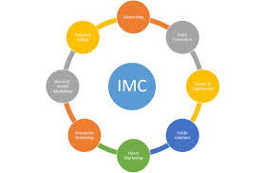
Chapter One
Define IMC
Marketing Mix
Marketing Communications Mix
7 elements
How they each contribute to communications objectives
The role of advertising
importance,
Product Lifecycle
Notes:
“Involves the coordination of all forms of marketing communications into a unified program that maximizes the impact upon consumers and other types of customers.” Tuckwell
“ The practice of unifying all marketing communication tools and corporate and brand messages to communicate in a consistent way to and with stakeholders audiences. IMC programs are designed to co-ordinate all various communication messages and sources.” Wells. Burnett and Moriarty, Advertising Principles.
Advertising is a paid form of marketing communication through the media that is designed to influence the thought patterns and purchase behaviour of a target audience.
Its primary role is to influence the behaviour of a target market (or target audience) in such a way that members of the target market view the product, service, or idea favourably.

Slide 6

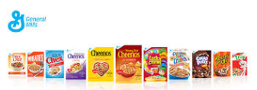

Chapter Two
Participants in the advertising industry
Roles & responsibilities of the agency, the client and their interaction
Services provided by an Ad Agency
Types of Advertising Agencies
Full Service, creative boutiques, media buying services, specialty agencies
Agency compensation methods
Commission based, fee system, payment by results
Notes:
Participants in the advertising industry include
Advertisers (Clients ) this is the industry component that most of the BM students would work in.
Agencies – there are a few roles in advertising agencies that are well suited for marketing graduates – we will discuss in a few slides.
Media- focus of the second half of the semester we will look at Broadcast, Print, Out of Home
Services:
Creative ad design and production
Media Buy
Marker Research
ReThink- Creative Boutique – text page 47 ( smaller in staff size, but ample experience as many major players from full service will go out on their ow. Fouc on creating the MESSAGE- client-centric creative ads- the BIG IDEA! But these independent think tanks will often get acquired after all by a larger agency.
Canmedia – Media Buying service – text page 48 ( Mediacom/Mindshare were clients that would negotiate very efficiently- buying multiple markets for various clients- so in the media world- you would serve these buyers as they were buying high volumes of inventory ( albeit at lower rates), for millions of dollars ( Media billings). These are important players to media companies.
Paradigmpr- Public relations specialist – text page 49 ( experiental marketing, including sales promo, events, and social to engage and connect with consumer in dialogue and personalized one on one
Green Lotus – Digital Specialist – text page 48 ( implementing online strategies acrossvarious devices/platforms and including gaming. Includes web design, Search engine marketing, display ads, rich media and may faciliate e-commerce etc. These specialists can often be acquired by larger full service agencies as well, or work is outsourced to them for their experitise.
Niche agency- specializing in specific industry/field or have experitise ( automotive/pharma) in a specfic target market “ millennial specilists!

Slide 7

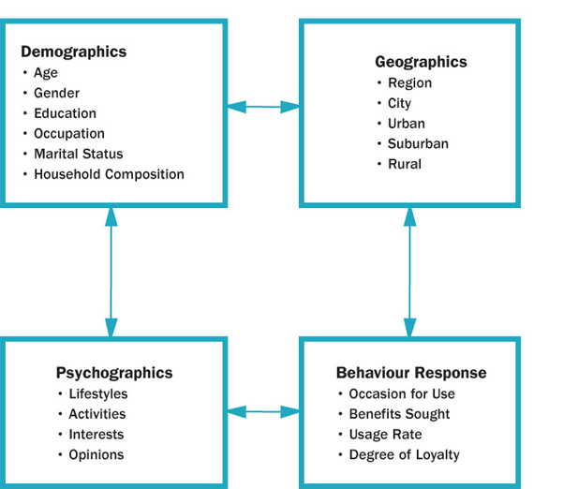
Chapter Three
Importance of segmentation
How segmentation is used in marketing communications
Segmentation Variables
Know each variable and its sub components and know how to apply them (demographics, psychographics (AIO), geographic, behavioural response)
Positioning
Importance of positioning
strategies (be able to recognize the 5 strategies)
NOTE: You do not need to memorize
positioning statement formula.
Repositioning
Notes:
Consumer knowledge is the key to developing successful positioning strategies.
Positioning strategies are critical component of IMC strategies and impact Creative strategy ( i.e. appeal techniques) and Media strategy
2 primary factors that impact positioning-
Competition
Target Market
Positioning strategies:
Head-on
Brand Dominance
Product Differentiation
Technical Innovation
Lifestyle

Slide 8
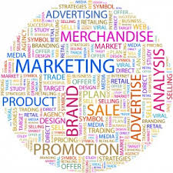
Chapter Four
The Marketing Plan
Marketing Objectives (SMART)
The WHAT
Marketing Strategies
The HOW
Execution Tactics
The Communications Plan
Communication Objectives (SMART)
Must be behavioural, quantified, with a timeline
The WHAT
Communications Strategies
The HOW
Notes:
MARKETING OBJECTIVES:
Identifies what the product/service will accomplish over a certain period of time.(ex. sales, market share etc.)
COMMUNICATION OBJECTIVES:
Defines the role that advertising/promotion will play in achieving stated marketing objective
Marketing
Objective = What the product/service will achieve
Strategy = How 4Ps
Communications
Objective = What marketing communications will achieve to support your product/service (behavioural)
Strategy = How 7 IMC elements

Slide 9

Chapter Five
Creative Development Process
Creative Brief
Creative Objectives (WHAT your message is to communicate)
Key Benefit to the target market
Support Claims to prove you can deliver on the key benefit
Creative Strategy (HOW your message will be communicated)
The big idea, the theme
Appeal techniques
How you will appeal to your target market
Use your target market, positioning strategy and creative objective to rationalize your choice here.
Notes:
Appeal techniques :Positive, Negative, factual, comparative, Humour, sexual

Slide 10
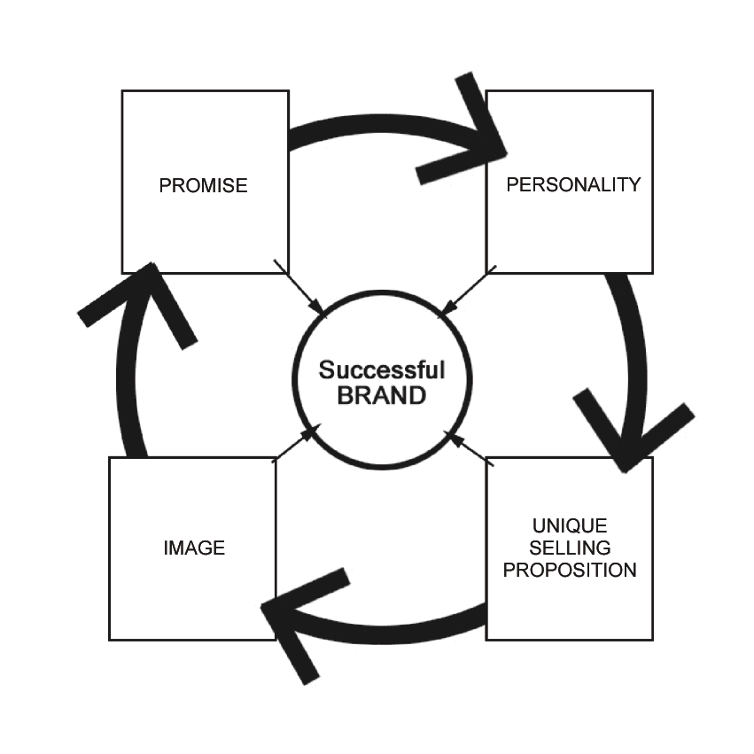

Chapter Five
Creative Execution
Tactical considerations
“What is the most convincing way to
present my product”
Presentation Tactics
Production Considerations
Branding (Week 5 ppt)
4 elements of a brand
Brand Character Statement
Giving your product/brand a personality
Notes:
Testimonials
Endorsements
Demonstrations
Product-as-Hero
Exaggerated demonstrations
Product Comparisons

Slide 11
MKT 2291 – Final Exam Review “HELPFUL HINTS”
Weekly Readings are vital!
Use weekly PowerPoint as guide to content
Review in class workshops and major assign.
READ ENTIRE EXAM FIRST
Allocate time according to value
Read questions carefully (i.e. examples, rationale)

Slide 12
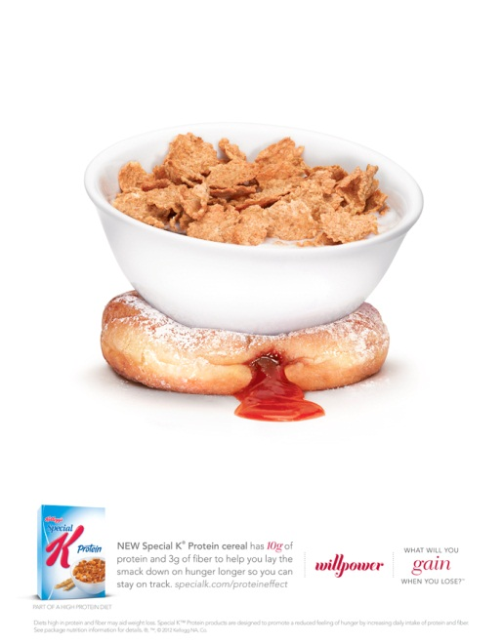



This magazine ad appeared in August 2019 in the following Canadian publications:
Women's Health (fitness)
Chatelaine (women’s fashion & style)
En Route (Air Canada in-flight magazine)
Headline: THE PROTEIN EFFECT
Sub Headline:
What will you gain when you lose?
willpower
Body Copy: New Special K Protein cereal has 10g of protein and 3g of fiber to help you lay the smack down on hunger longer so you can stay on track. specialk.com/proteineffect
Diets high in protein and fibre may aid weight loss. Special K Protein products are designed to promote a reduced feeling of hunger by increasing daily intake of protein and fiber.
Notes:
This is an example of the Advertisement your will be emailed for Part A of the midterm exam.
Remember to consider the publications as well as the Advertisement when answering the questions.

